Slide 1


Flutter
“There’s a Widget for that”
“Beyond Hello World”
By Scott Stoll
A number of these slides were shamelessly stolen with
permission from Ahmed Abu Eldahab (Flutter Egypt) and Pascal Welsch
@scottstoll2017

Slide 2

What is Flutter?
What is Flutter?
flutter.io
flutter.io
A multi-platform mobile app SDK
●
A multi-platform mobile app SDK
●
for Android, iOS and Fuchsia
for Android, iOS and Fuchsia
Uses Dart - compiles to efficient ARM code
●
Uses Dart - compiles to efficient ARM binary
●
Rich Widget catalog
●
Rich Widget catalog
●
Modern, React inspired View-Framework
●
Modern, React inspired View-Framework
●
Notes:
It’s cross platform because it runs on multiple platforms but that’s actually a side effect of the approach.
.
It’s designed to take over the device and render straight to the canvas. It was only after playing with this idea in that they realized it would actually work cross platform.
.
No JVM. In fact, in production code there is no VM, as long as you aren’t counting the techniques needed to access the physical ram, etc. That doesn’t count as what we call a VM.
.
Widgets, widgets everywhere.

Slide 3
Flutter goals
●
Builds beautiful, fluid UIs
●
High-performance apps that feel natural on
different platforms
●
Rapid prototyping let’s you experiment freely.
●
Runs the same UI on multiple platforms, perfect
for custom branded designs
Notes:
Because of the approach, you can build UI’s that are only limited by your imagination. You’re not limited to the OEM widgets.
.
Can’t distinguish the UI from it’s OEM conterpart
.
Hot reload and hot restart can let you try 3, 4, 5 variations in a single minute.
.
Can make the UI look identical everywhere.

Slide 4

What makes Flutter unique?
Compiles to Native Code (ARM Binary code)
Not reliant on OEM widgets
Unlike React, there’s no bridge needed
No VM in the release code to slow things down
Debug builds are JIT compiled, allowing for Rapid Prototyping
Flutter
Notes:
Release code is AOT for running fast
Debug code is JIT for coding fast
.
Doesn’t use OEM widgets, but does deceive you into thinking it does.
.
No bridge to slow things down
.
There is no JVM because there is no Java
.
Little left… no, a little right. Is it crooked? I think it’s crooked… what about blue? I like blue...

Slide 5
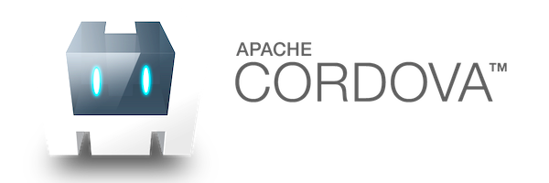






Mobile Development Approaches
JavaScript
C#
JavaScript
JavaScript

Slide 6
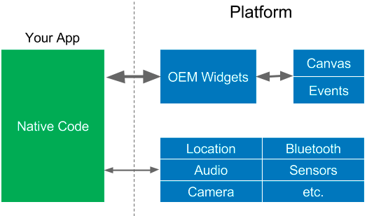
OEM SDKs

Slide 7
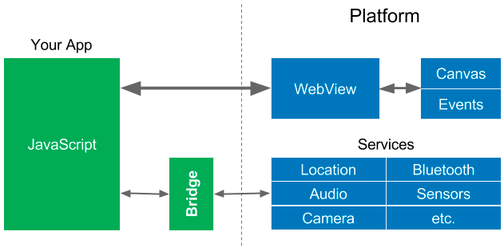
WebViews

Slide 8
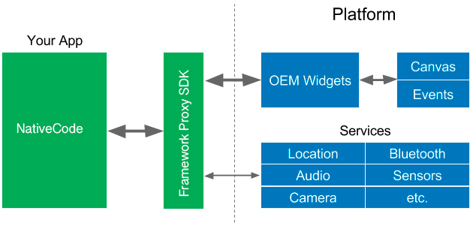
Native Proxy SDK

Slide 9

Reactive Views

Slide 10

Flutter’s Approach
Google Flutter

Slide 11
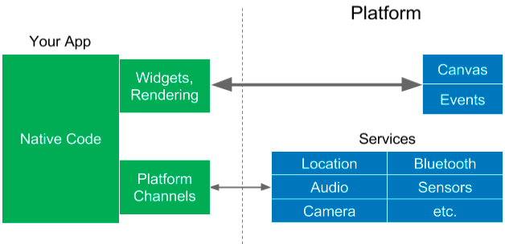
Flutter approach
Notes:
Platform Channels are needed to access services but they also allow you to use any part of the underlying framework you want. You could put a recyclerView inside of a flutter UI if you wanted to.
.
UNDER THE HOOD
Android launches an activity called Flutter Activity and runs it like any other app. For graphics it creates a SurfaceView and draws directly to a GPU Texture.
In iOS Flutter uses UI View Controller.

Slide 12
App
Platform OS
Canvas
OEM Widgets
Input Events
React Native
JavaScript
Bridge
System Services
(Location, Bluetooth, Audio, Camera,
Sensors, etc.)
Canvas
Widget
Rendering
Input Events
Flutter
Dart ARM
code
System Services
Platform
(Location, Bluetooth, Audio, Camera,
Channels
Sensors, etc.)
All Native Binary! NO JS. NO VM.

Slide 13


Dart?
dartlang.org

Slide 14


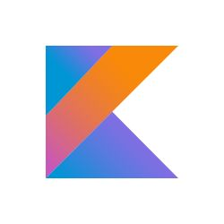


The History of
“We can rebuild him.
We have the technology.
Make him stronger, faster, better than he was before...”
“Dart is Dead”
“Dart Sucks!”
“NOBODY uses Dart”
2011
2013
2014
2015
2018
Goal:
Dart 1.0
No Dart
for Chrome!
Fail Whale!
Roadmap: Dart
Compile to
Dart 2.0
Replace
2.0 announced
ARM
dev preview
JavaScript in
JIT only
for
Chrome.
Rule the
World!
early 2016
Make Dart and tools
Move to AOT
multiplatform
Introduce Strong mode;
async/await
Web, mobile, Dart VM

Slide 15

What is Dart?
Open-source web programming language developed by Google.
Class-based, single-inheritance, object oriented language with C-style syntax.
Supports interfaces, abstract classes, reified generics, and optional typing(Dart 1) and strong typing (Dart 2)..
One language to rule them all..

Slide 16
Who use Dart?
Google AdWords
Google Fuchsia
Google Fiber
AdSense
performance reports
Mandrill
AdWords for video
Google internal sales tool
Google internal CRM
Adobe
https://www.dartlang.org/community/who-uses-dart
Notes:
Think about this:
AdWords and AdSense are Google’s cash cows. They’re the reason Google currently has more than one Billion dollars in cash.
Do you seriously think they would trust that to any language that sucks?

Slide 17
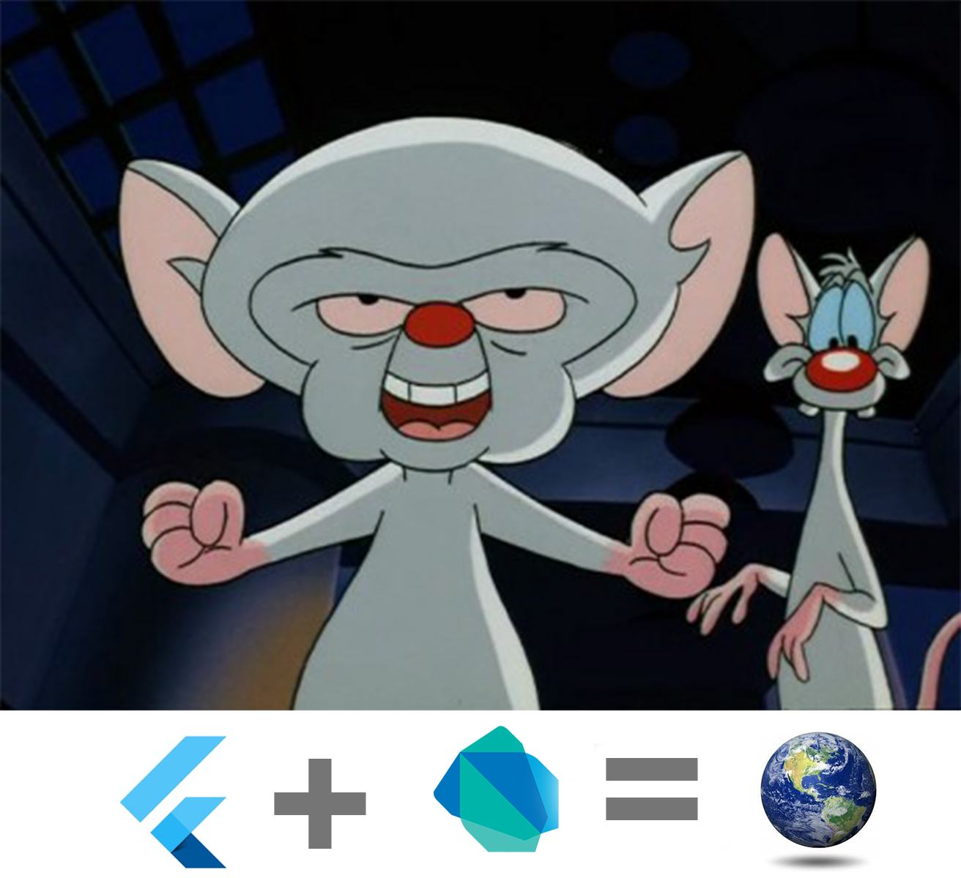
What’s next?
(They have a Secret Weapon)

Slide 18

Introducing:
Google Fuchsia
Fuchsia is a capability-based, real-time operating system (RTOS) currently being developed by Google.
https://github.com/fuchsia-mirror/
Notes:
Serve real-time applications that process data as it comes in, typically without buffer delays. Processing time requirements (including any OS delay) are measured in tenths of seconds or shorter increments of time.
.
A real time system is a time bound system which has well defined fixed time constraints. Processing must be done within the defined constraints or the system will fail.
.
They either are event driven or time sharing. Event driven systems switch between tasks based on their priorities while time sharing systems switch the task based on clock interrupts.
.
A key characteristic of an RTOS is the level of its consistency concerning the amount of time it takes to accept and complete an application's task; the variability is jitter.
.
Key factors in a real-time OS are minimal interrupt latency and minimal thread switching latency; a real-time OS is valued more for how quickly or how predictably it can respond than for the amount of work it can perform in a given period of time

Slide 19
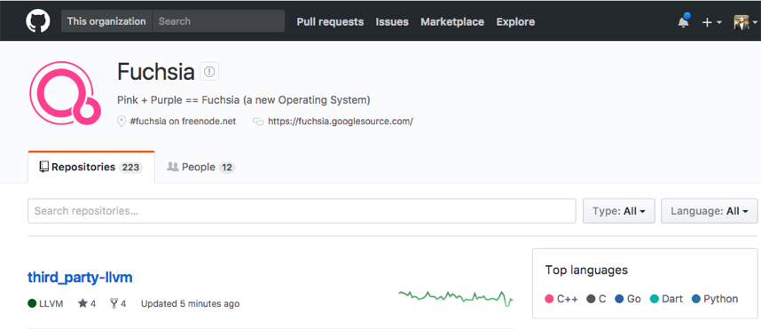

Google Fuchsia
https://github.com/fuchsia-mirror/
Notes:
Have you downloaded it yet?

Slide 20
So how does this work?
Flutter

Slide 21
Widget Rendering
App
Platform OS
Canvas
Widget
Rendering
Events
Flutter
Native
Flutter Code
System Services
Platform
(Location, Bluetooth, Audio, Camera,
Channels
Sensors, etc.)
Notes:
Widgets are inside your app, not in the device’s framework.
.
This means it doesn’t matter what the phone’s limitations are. Whatever widgets you can create in Flutter, that’s what’s going to show on your phone.

Slide 22
What are Widgets?
●
Widgets are immutable
class PaddedText extends StatelessWidget {
declarations of parts of the UI
final String _data;
●
Like a
<div/>
PaddedText(this._data, {Key key})
: super(key: key);
●
a structural element
@override
(e.g. button, menu)
Widget build(BuildContext context) {
return new Padding(
●
a stylistic element
padding: const EdgeInsets.all(4.0),
child: new Text(_data,
(themes, styles, fonts)
style:
const TextStyle(fontSize: 18.0))
●
an aspect of layout
);
}
(padding, center)
}
Notes:
A little in the weeds:
Notice that widgets are not actually the parts of the UI, they’re declarations of parts of the UI.
.
They’re classes, but your UI widgets are instances of these classes. Those are called Elements.
.
You can unit test your UI. Don’t forget to pump the widget.
.
Widgets are structural, like Text
Widgets are stylistic, like TextStyle
Widgets are layout, like Col Row and Padding

Slide 23
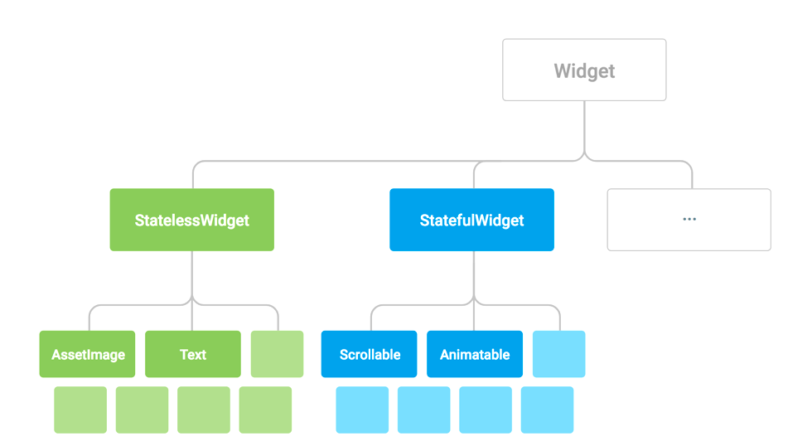
Everything is a Widget
Notes:
Every thing is a widget.
Text is a widget.
Padding
The whole app is one big widget.
When we say everything, we mean everything... you coffee cup, your keyboard, your dog is a widget

Slide 24
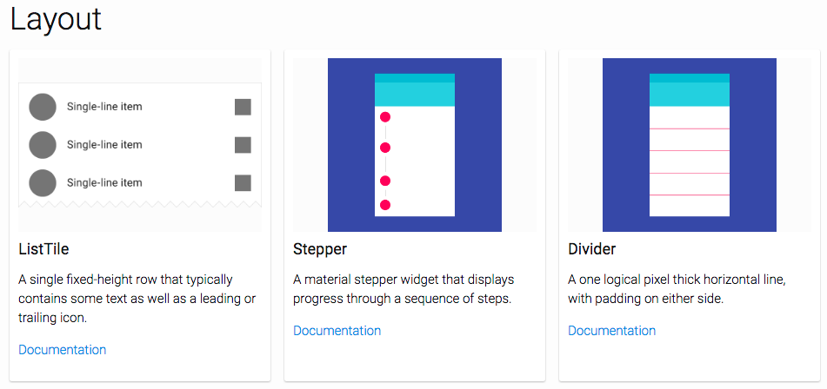
https://flutter.io/widgets/widgetindex/
Notes:
Discuss various layout widgets
.
“There’s a widget for that”
.
Many people use a SizedBox or container with 1dp height and a color to make a line. Why do that when we have a divider? “There’s a widget for that”

Slide 25
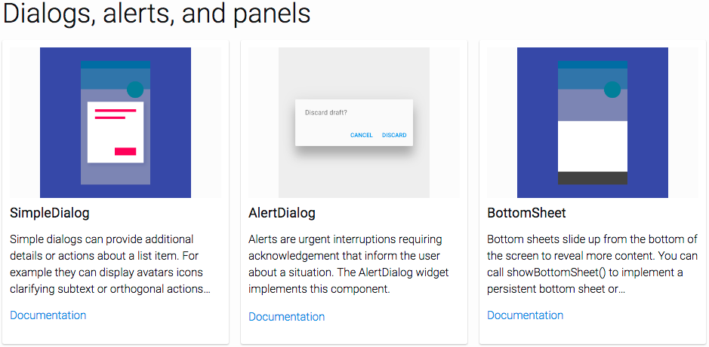
https://flutter.io/widgets/widgetindex/
Notes:
Pre-made dialogs, popups, tabbed menus and more make it easy.

Slide 26
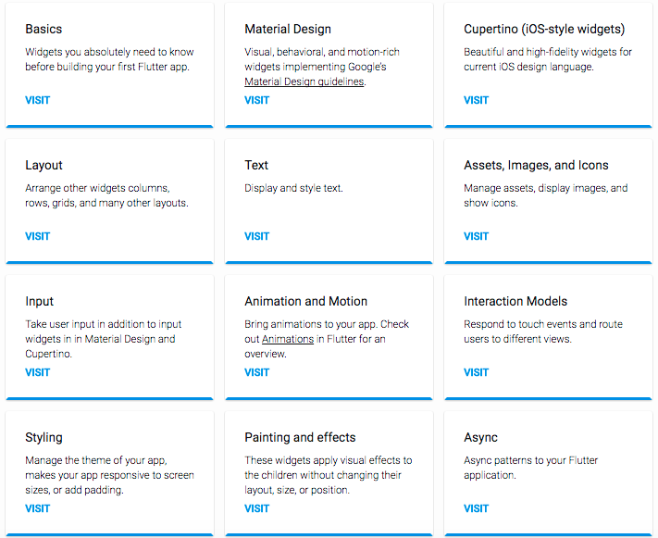
https://flutter.io/widgets/
Notes:
The widget catalog is easy to browse so you can find just what you need.
.
Have you ever tried to browse the Android documentation?

Slide 27
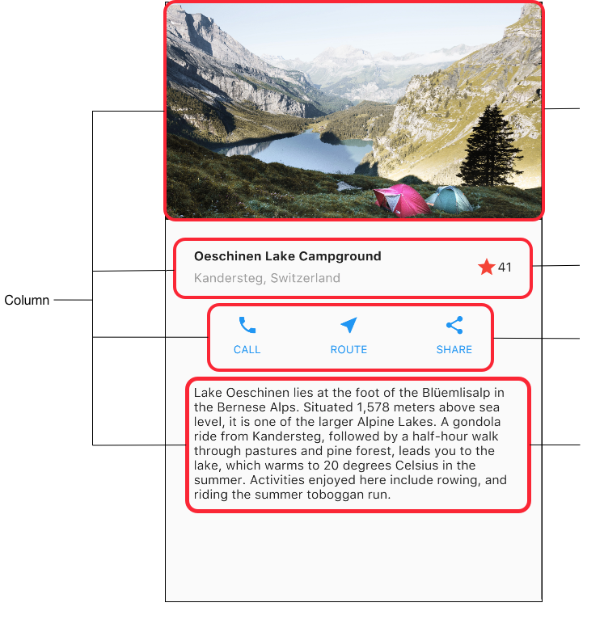
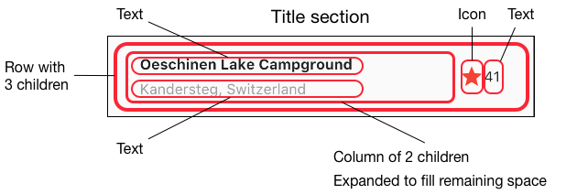
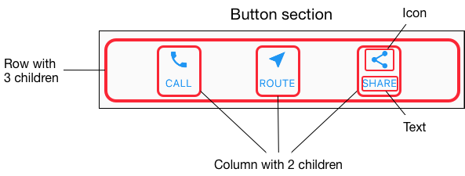
Rows and columns
Notes:
You can create UI components and reuse them.
.
You don’t need to use a table to lay everything out. There is a property called offset, that allows you to control exactly where a child is placed within its parent.

Slide 28
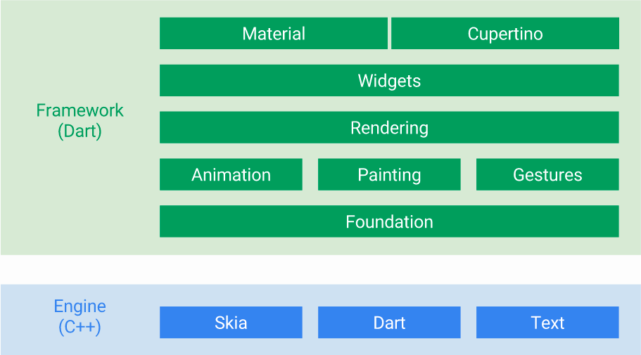
You Can customize everything in green
Notes:
Yes, foundation means the base of the SDK, right down to the definition of widget itself.
.
Though you supposedly can’t change text, you can change just about anything about it. From font family and size to line height, and you can even set font weight by w numbers rather than just “Normal”, “Bold” etc. IE: w300, w700, etc.

Slide 29
Flutter

Slide 30
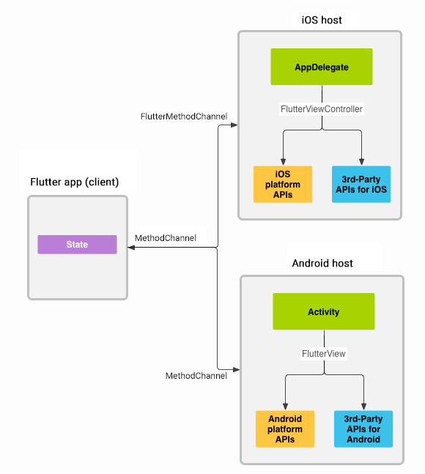
Platform channels
Flutter
https://flutter.io/platform-channels/

Slide 31
What makes Flutter unique ?
Flutter

Slide 32
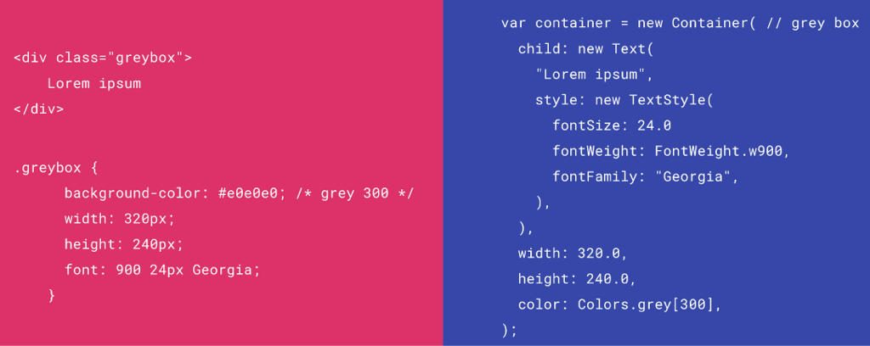
HTML/CSS Analogs in Flutter

Slide 33
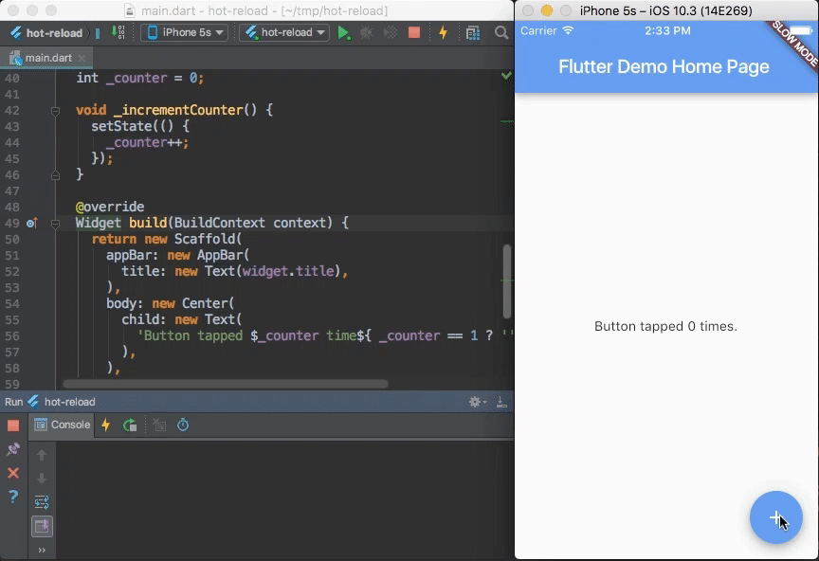
Hot Reload and Hot Restart

Slide 34
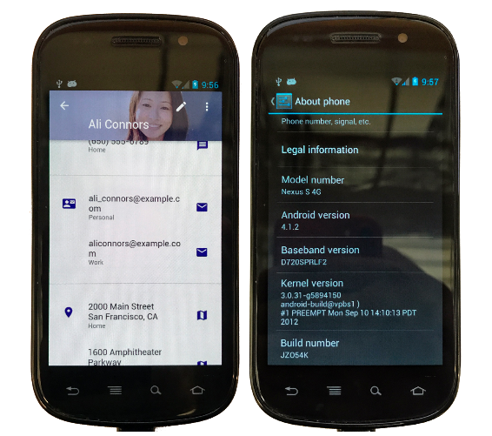
Consistent Material Design (or your design) on phones made way before Material Design existed

Slide 35





IDE Support ?

Slide 36
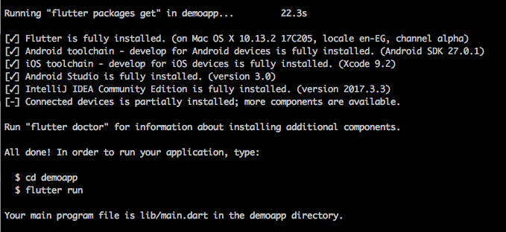
Terminal ?
$ flutter create demoapp

Slide 37
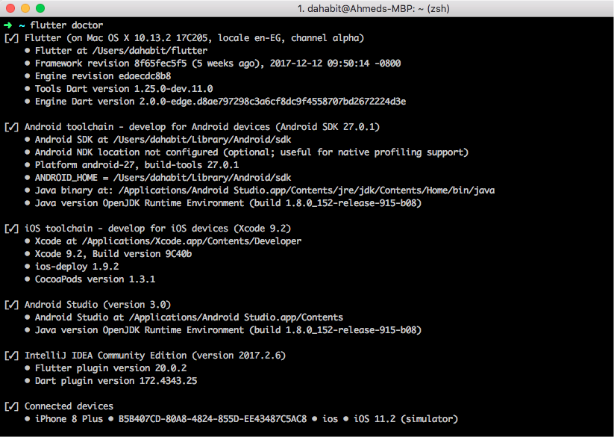
Easy Check !
$ flutter doctor

Slide 38
Over 200 Apps
are already on the Google Play Store!
(Did someone say not production ready?)

